Slide 1
Customer
Segmentation

Slide 2
Customer segmentation process:
Understand
customer needs
1
2
3
4
5
Develop unique Go to Market strategies by segment
Group customers
by need groups
Identify most
Attractive segments
Develop unique value
propositions by segments

Slide 3
Process of customer segmenation by Machine Learning:
Identify customer
habits and
preferences using
AI models.
such as number of
products ordered,
average return,
rate etc.
Use K-Means clustering
to obtain customer data
using machine learning.
Identical groups of
customers combined
together
Make use graphs and
charts to find out most
profitble segments.
Select the most
genuine and
achievable segment.
Organise data based
on more crucial
customer data sets.
Such as life time
value, customer
purchased cost,
customer feedback
etc.
Use Elbow method
to optimise segments.
select value which
stabilises the segment
results.
Design
business
case
Develop
segments
Visualistion
of results
Prepare
Data
Tune
hyperparameter

Slide 4
Data of Milk
Given the data of milk production company.
This company is selling milk packets in the cities Dar es salaam, Moshi, Mtwara, Zanzibar city.
Now will make the identical groups of customers by using the customer segmentation process.
In this process we plot the Elbow curve to optimize the cluster number(using inertia).
Using K-Means clustering algorithm in Machine learning we determine the clusters.
Finally visualise the results .

Slide 5
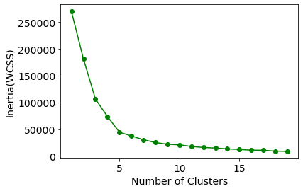
Elbow Curve:

Slide 6
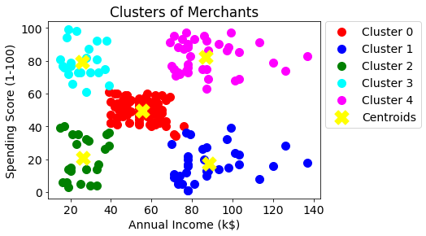
Visualising the clusters:

Slide 7
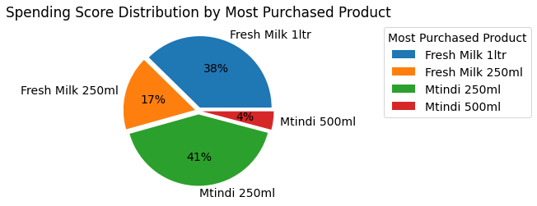
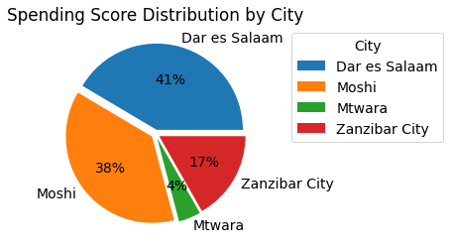

Slide 8
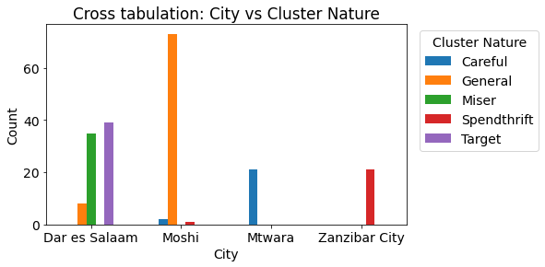
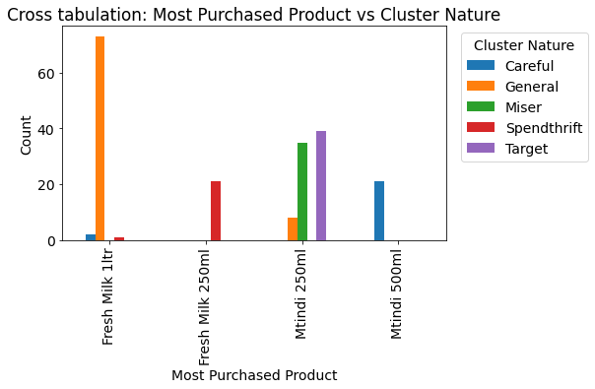
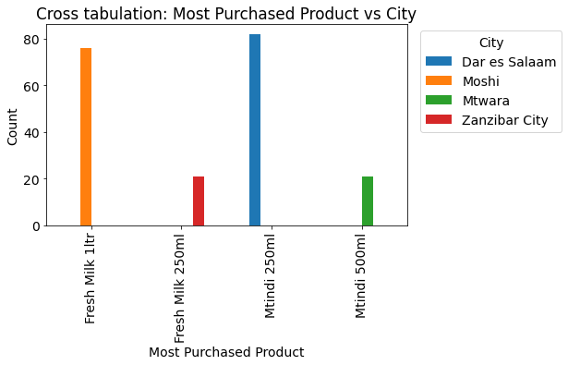

Slide 9
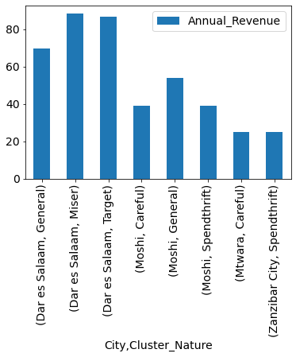
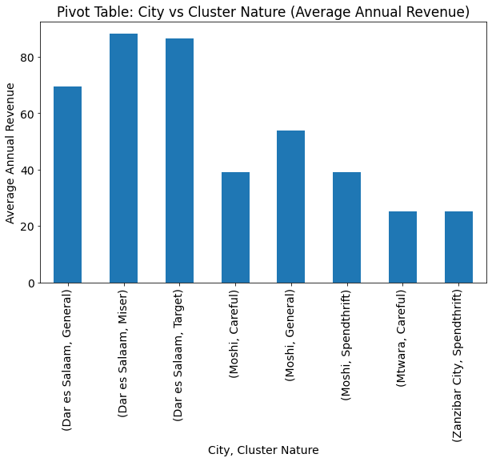

Slide 10
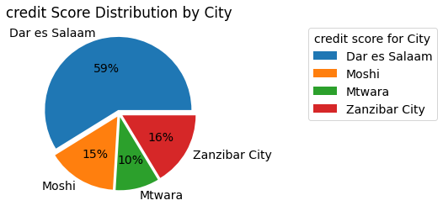
Credit Score Distribution:

Slide 11
Thank You

